Slide 1
Week9 Activities
Cloud Services
Tevin Herath

Slide 3
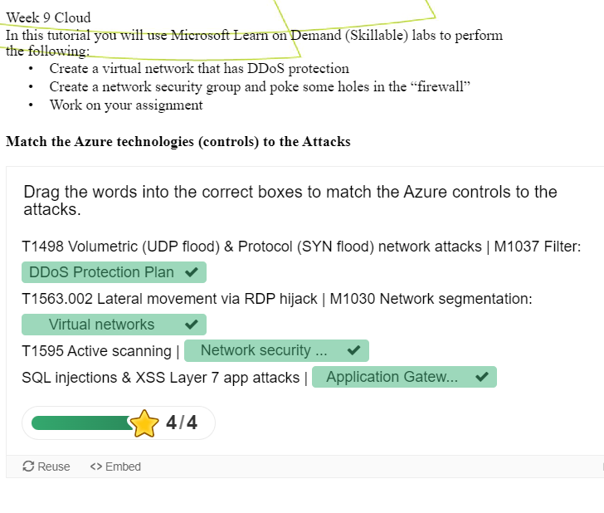
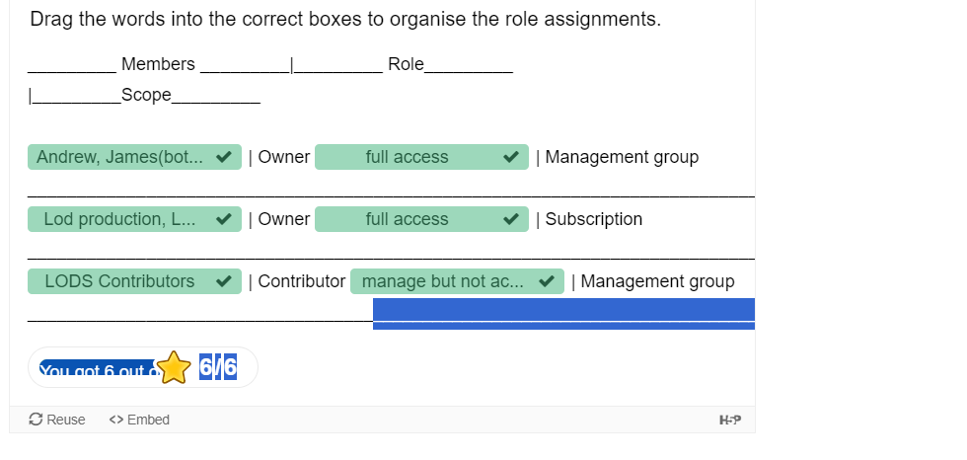
Week 9 Handout

Slide 4
Self reflection

